Slide 1
Local histogram processing
The histogram processing methods mentioned up to now are global transformations where:
Function is designed according to the gray-level distribution over an entire image
Global transformation methods may not be suitable for enhancing details over small areas (where number of pixels may have negligible influence on designing the global transformation function)
COMSATS University Islamabad, Lahore Campus Digital Image Processing CSD 331

Slide 2
Local histogram processing
Implementation steps
1: Define a square or rectangular neighborhood (block), compute the histogram in the local block
2: Generate the transformation function by histogram equalization and perform the gray level mapping for each pixel
3: Move the center of the block to an adjacent pixel location and repeat the procedure
Note
If utilizing non-overlapping region shift, the processed image usually has an undesirable checkerboard effect
COMSATS University Islamabad, Lahore Campus Digital Image Processing CSC 331

Slide 3
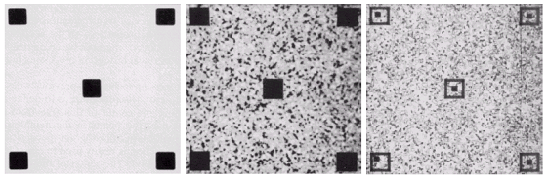
Local histogram processing - example
Result of Global Histogram Equalization
Result of local Histogram Equalization
Original Image
COMSATS University Islamabad, Lahore Campus Digital Image Processing CSD 331

Slide 4
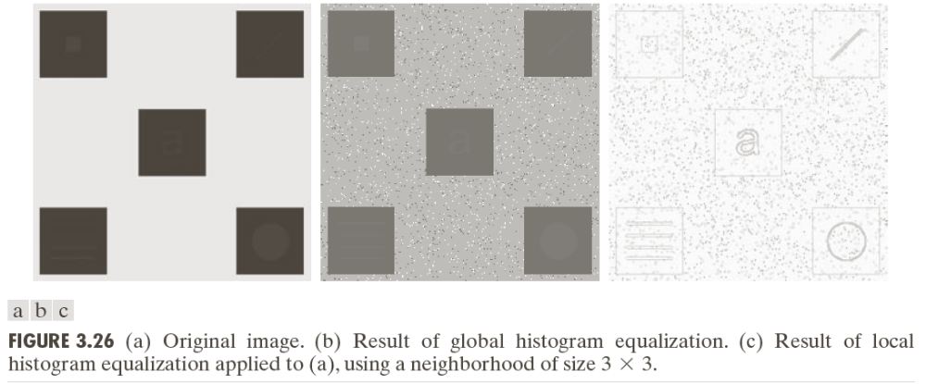
Local histogram processing - example
COMSATS University Islamabad, Lahore Campus Digital Image Processing CSD 331

Slide 5
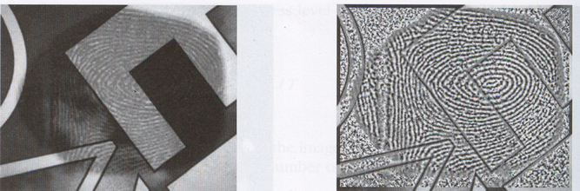
Local histogram processing - example
Original Image
Result of local Histogram Equalization using 9x9 window
COMSATS University Islamabad, Lahore Campus Digital Image Processing CSC 331

Slide 6
Local enhancement using statistical parameters from histogram
Local enhancement can be based on statistical properties of the gray levels in a block instead of using full histogram
Examples:
Mean gives the average intensity of the image (smoothing)
Variance (σ²) and its square root the standard deviation gives the deviation of intensities on average from the mean value (measure of contrast)
To compute mean, there are two methods, first is to sum all the
probabilities by its corresponding pixel value of which we have
computed probability. Second way is to sum all the pixel intensities
and divide by size of image like 25 in next slide. To find variance,
Subtract mean we have found from each pixel and find its square and
divide it by total size of image.
COMSATS University Islamabad, Lahore Campus Digital Image Processing CSC 331

Slide 7
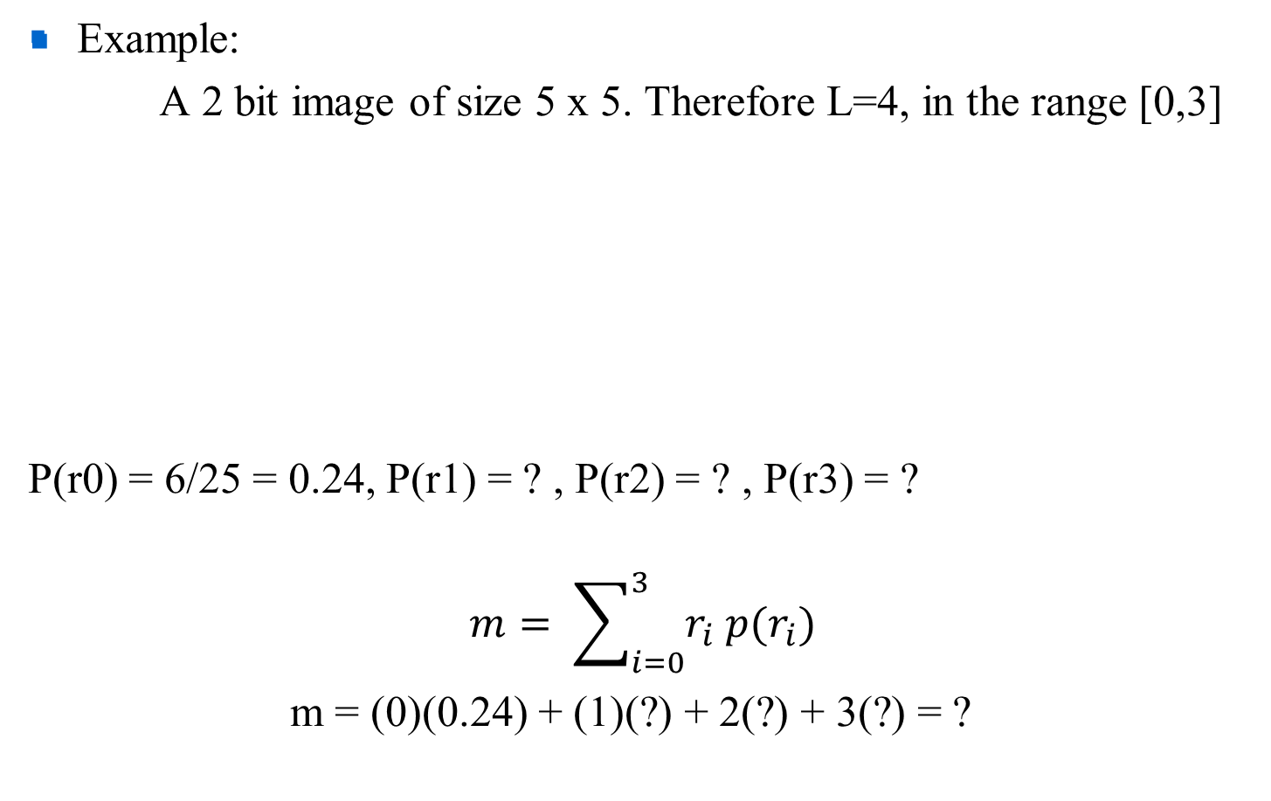
Local enhancement using statistical parameters
0 | 0 | 1 | 1 | 2
1 | 2 | 3 | 0 | 1
3 | 3 | 2 | 2 | 0
2 | 3 | 1 | 0 | 0
1 | 1 | 3 | 2 | 2
0(0.24)+1(0.28)+2(0.28)+3(0.2) = 1.44
COMSATS University Islamabad, Lahore Campus Digital Image Processing CSC 331

Slide 8
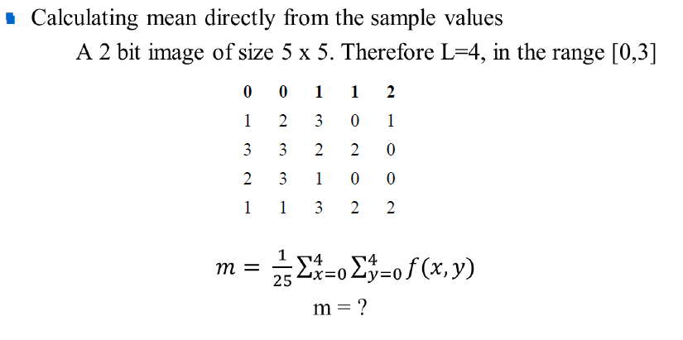
Local enhancement using statistical parameters
0 + 0 + 1 + 1 + 2 + 1 + 2 + 3 + 0 + 1 + 3 + 3 + 2 +
2 + 0 + 2 + 3 + 1 + 0 + 0 + 1 + 1 + 3 + 2 + 2 = 34/25 = 1.36
COMSATS University Islamabad, Lahore Campus Digital Image Processing CSC 331

Slide 9
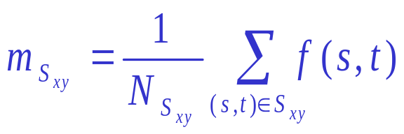
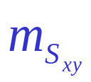
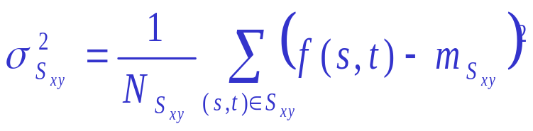
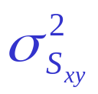
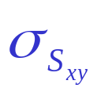
Local enhancement using statistical parameters
S_{xy} : a neighborhood (subimage) of size N_{Sxy}; a block centered at (x,y)
: gray-level mean in S_{xy}
: gray-level variance in S_{xy}
: standard deviation, square root of variance
M_{G} : global mean of f(x,y)
D_{G} : global standard deviation of f(x,y)
COMSATS University Islamabad, Lahore Campus Digital Image Processing CSD 331

Slide 10
Variance calculation:
Original matrix
After subtracting mean from each pixel
0 | 0 | 1 | 1 | 2
1 | 2 | 3 | 0 | 1
3 | 3 | 2 | 2 | 0
2 | 3 | 1 | 0 | 0
1 | 1 | 3 | 2 | 2
-1.36 -1.36 -0.36 -0.36 0.64
-0.36 0.64 1.64 -1.36 -0.36
1.64 1.64 0.64 0.64 -1.36
0.64 1.64 -0.36 -1.36 -1.36
-0.36 -0.36 1.64 0.64 0.64
Square of each pixel:
1.8496 1.8496 0.1296 0.1296 0.4096
0.1296 0.4096 2.6896 1.8496 0.1296
2.6896 2.6896 0.4096 0.4096 1.8496
0.4096 2.6896 0.1296 1.8496 1.8496
0.1296 0.1296 2.6896 0.4096 0.4096
Sum = 23.64
Variance = (sum of
Squared pixel – (mean of matrix)2 / size of matrix = 23.64 / 25 = 0.94
COMSATS University Islamabad, Lahore Campus Digital Image Processing CSD 331

Slide 11
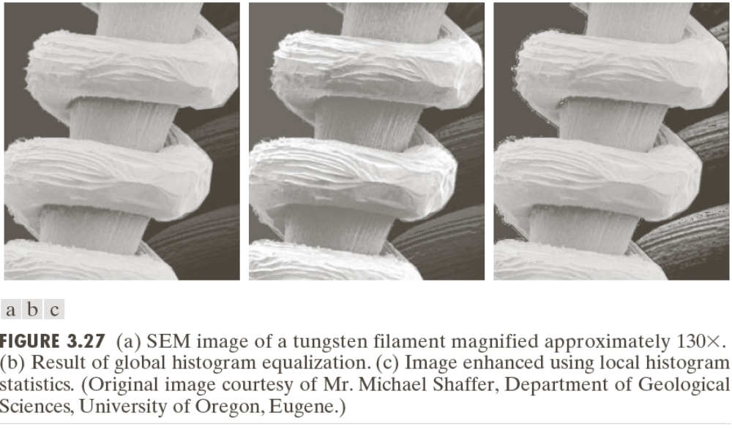
Local enhancement using statistical parameters
COMSATS University Islamabad, Lahore Campus Digital Image Processing CSD 331

Slide 12
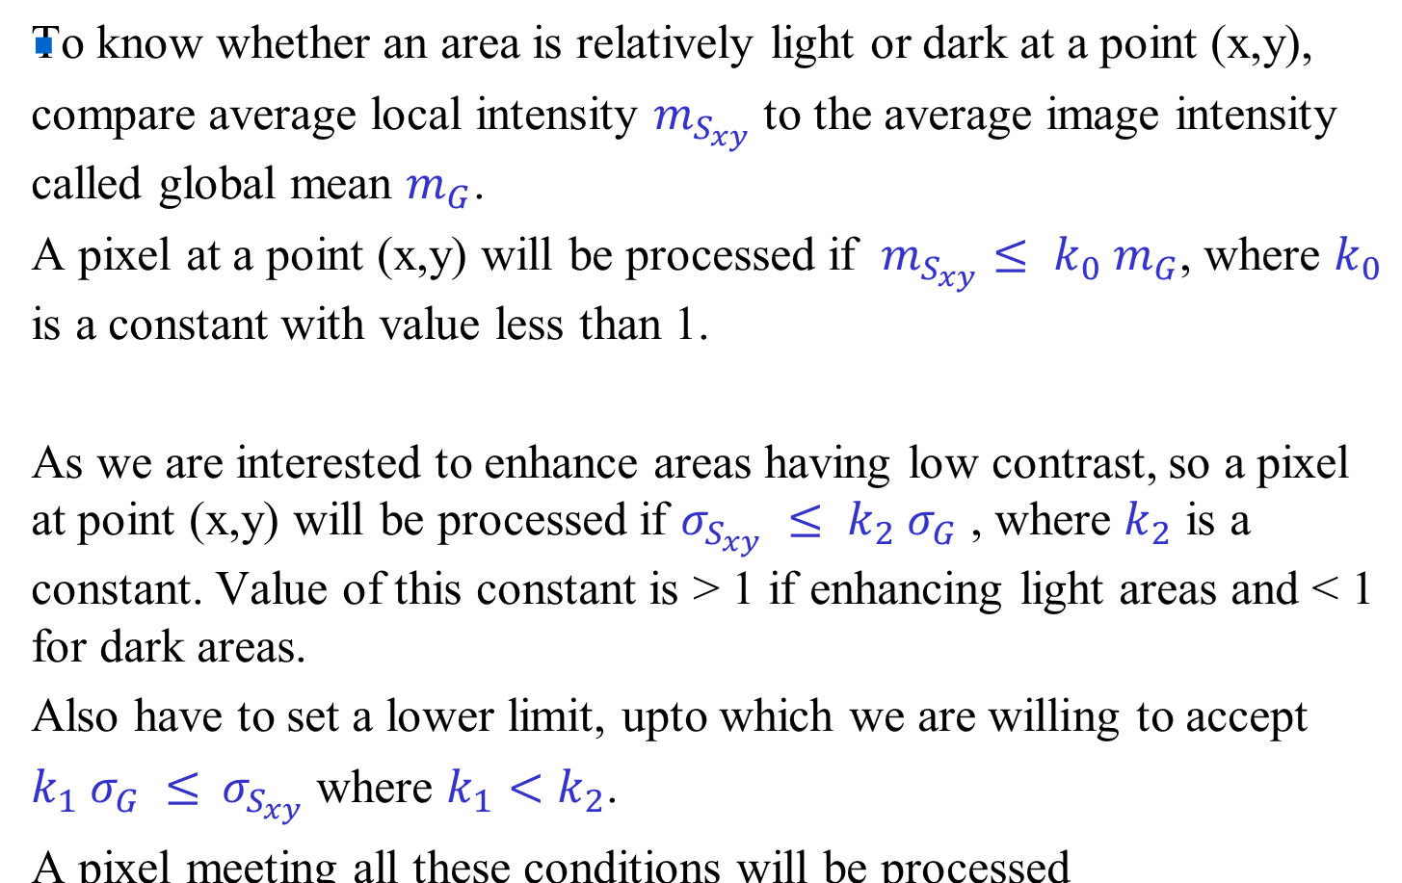
Local enhancement using statistical parameters
COMSATS University Islamabad, Lahore Campus Digital Image Processing CSD 331

Slide 13
Example:
The expression is related to the relationship between the standard deviation of the noise in an image and the standard deviation of the filtered image, where the filter is a linear filter applied to the noisy image. The constants k1 and k2 are related to the properties of the filter used.
To explain this relationship, let's consider a simple case of applying a linear filter to a noisy image. When a linear filter is applied to an image, the output pixel value at any location is a weighted average of the pixel values in a neighborhood around that location. The weights are determined by the filter kernel, which defines the size and shape of the neighborhood and the coefficients of the weights.
If the image is corrupted by additive white Gaussian noise with standard deviation σG, then the standard deviation of the pixel values in the neighborhood around a given location will also be σG. When the filter is applied, the output pixel value will be a weighted sum of these noisy pixel values, and the resulting standard deviation of the filtered pixel values will be larger than σG, due to the averaging process.
COMSATS University Islamabad, Lahore Campus Digital Image Processing CSD 331

Slide 14
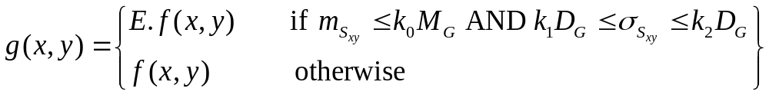
Local enhancement using statistical parameters
Using them in defining ranges for different transfer functions for example
where E, k₀, k₁, k₂, are specified parameters
COMSATS University Islamabad, Lahore Campus Digital Image Processing CSD 331

Slide 15
Local enhancement using statistical parameters
COMSATS University Islamabad, Lahore Campus Digital Image Processing CSD 331

Slide 16
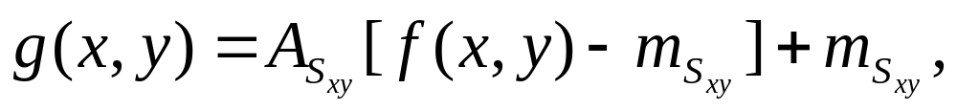
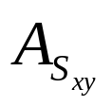
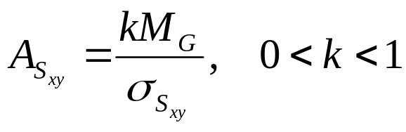
Local enhancement using statistical parameters
The statistical parameters can be used in various ways:
For the direct calculation of transformation function (adaptive transformation function) for example
where is the local gain factor,
COMSATS University Islamabad, Lahore Campus Digital Image Processing CSD 331

Slide 17
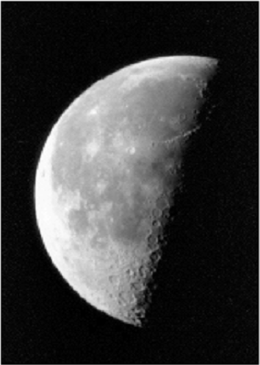
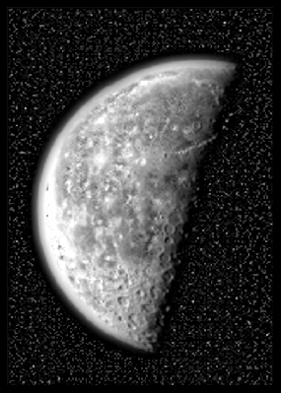
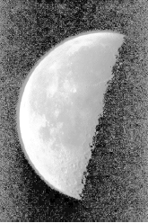
Local enhancement with adaptive transformation function
Original moon image
Image enhanced using adaptive transformation, window size: 15x15, k = 0.5
Histogram equalized image
COMSATS University Islamabad, Lahore Campus Digital Image Processing CSD 331

Slide 18
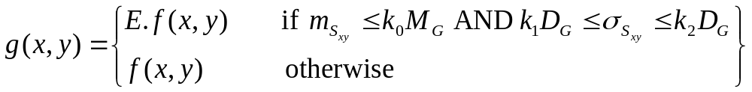
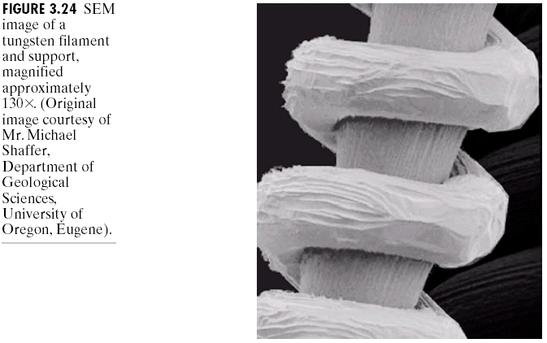
Local enhancement using statistical parameters
Defining ranges for different transformation functions
COMSATS University Islamabad, Lahore Campus Digital Image Processing CSD 331

Slide 19
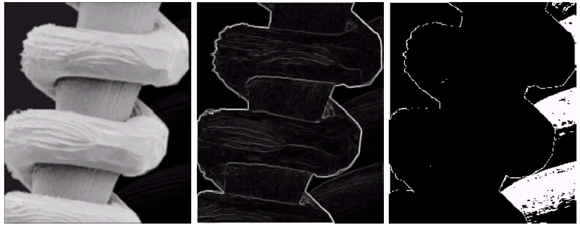
Local enhancement using statistical parameters
E = 4.0, k₀ = 0.4, k₁ = 0.02, and k₂ = 0.4,
COMSATS University Islamabad, Lahore Campus Digital Image Processing CSD 331

Slide 20
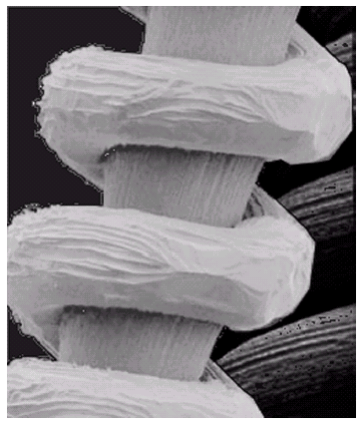
Local enhancement using statistical parameters
Input microscopic image
Enhanced output image
COMSATS University Islamabad, Lahore Campus Digital Image Processing CSD 331

Slide 21
Reading Assignment
Chapter 2 and Chapter 3 (Complete, except the topics left)
COMSATS University Islamabad, Lahore Campus Digital Image Processing CSD 331

